Slide 1
Lab class - INFSCI 2710
Fan Yang
https://github.com/yfamy123/INFSCI2710-lab

Slide 2
Outline
Three software products
Why do we need 3 different software products?
Create Web page
MySQL workbench / phpMyAdmin
Static web page
Dynamic web page
Class exercise

Slide 3
Preparation
Install the software:
WAMP for windows
MAMP for Mac
LAMP for linux.
Install code editor
Sublime / Atom/ Notepad ++
Download the lab materials from GitHub link, or class webpage.
https://github.com/yfamy123/INFSCI2710-lab
http://www.pitt.edu/~vizclass/classes/infsci2710/
If fail to install the software or forget to take the laptop, find a partner and sit together.

Slide 4
Statistics
HTML programming ?
PHP/JSP/ASP experience ?

Slide 5
Three software products

Slide 6
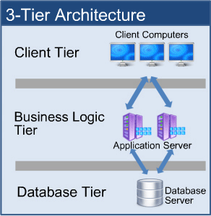
When you login in to Facebook…
http://www.simcrest.com/blog/BlogEntry/35
Notes:
Login example. Login in pitt/facebook.

Slide 7



Why do we need 3 different software products?

Slide 8
What is MySQL?
“The world's most popular open source database”
Popular GUI:
phpmyadmin (www.phpmyadmin.net);
MySQL Workbench (www.mysql.com/products/workbench)
Other popular RDBMS: Oracle, MS SQL Server, PostgreSQL, SQLite

Slide 9
What is Apache?
”A robust, commercial-grade, featureful, and freely-available source code implementation of an HTTP (Web) server”
Other popular web servers: nginx, Microsoft IIS,…
Servlet containers and http web servers: Tomcat, Jetty,…

Slide 10
What is PHP?
“a popular general-purpose scripting language that is especially suited to web development.”
Install PHP runtime environment, so Apache understands.
PHP can generate HTML

Slide 11


MySQL workbench / phpMyAdmin
GUI to work with MySQL [demo]
Login (be very careful when change the password!!)
Create databases
Create a table
Insert some data
Update data
Delete data
Drop the table
Default username: root
Default password: no password

Slide 12
Online materials
MySQL command line tutorial:
https://www.digitalocean.com/community/tutorials/a-basic-mysql-tutorial
PHP tutorial:
http://www.w3schools.com/php/default.asp

Slide 13
Design web pages

Slide 14
My SQL
Start MAMP/WAMP/LAMP server
Open WebStart Page (change the link based on your software and port)
http://localhost:8888/MAMP/
http://localhost/MAMP/
Open PhpMyAdmin
http://localhost:8888/phpMyAdmin/?lang=en
http://localhost/phpMyAdmin/?lang=en
Login with username: root, no password needed

Slide 15
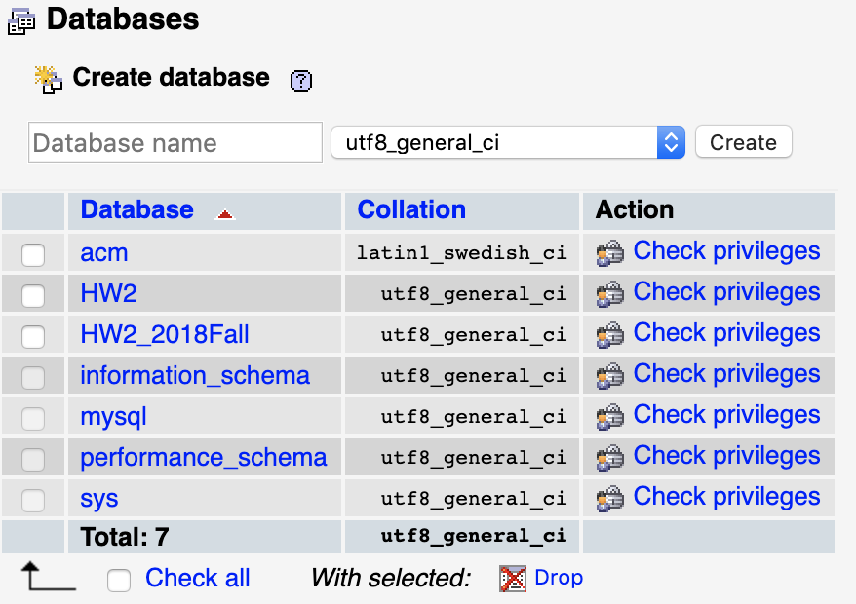
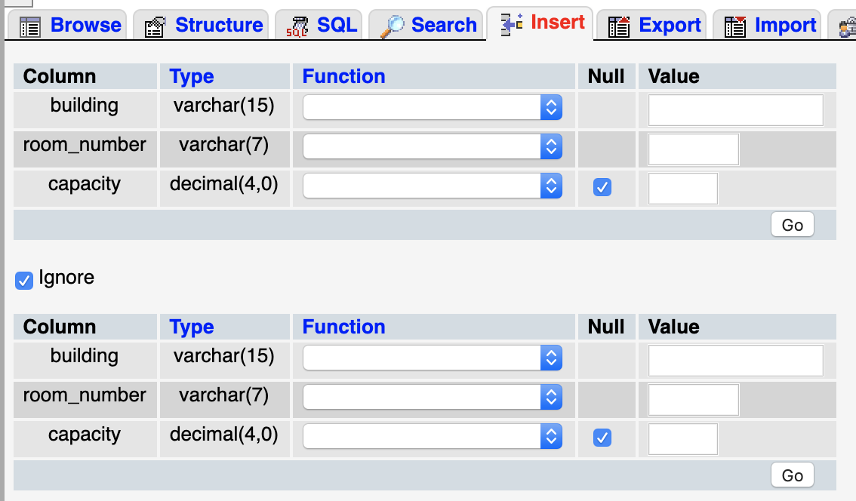
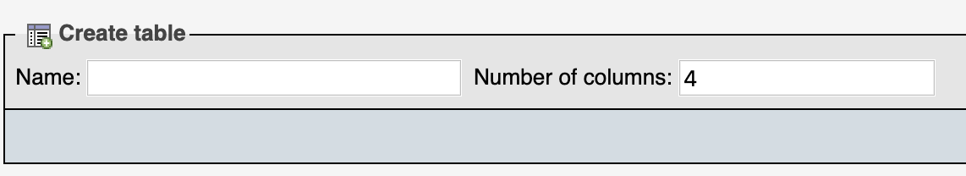
Create databases
Insert data
Create tables
Update data
Delete data
Drop the table
Notes:
去购买更新于2小时前
SkinStore

Slide 16
CREATE DATABASE databasename;
DROP DATABASE databasename;
CREATE TABLE table_name ( column1 datatype, column2 datatype, column3 datatype, .... );
DROP TABLE table_name;
INSERT INTO table_name (column1, column2, column3, ...) VALUES (value1, value2, value3, ...);

Slide 17
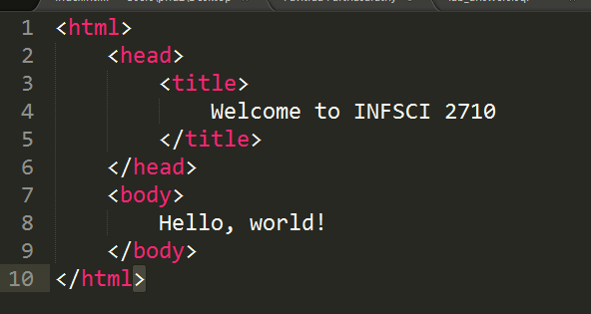
1 - Static web page
Go to Apache Document Root, the place where you installed WAMP/MAMP/LAMP
On Windows go to wamp/www
On Mac go to mamp/htdocs
On Ubuntu, it is usually /var/www[/html]
Create a new text file and name it: test1.html

Slide 18
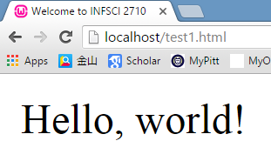
1 - Static web page
Open your favorite web browser and navigate to localhost/test1.html
By default port 80 is used, but if you apache is configured to listen to a different port, then add appropriate port number as well, e.g. localhost:8888/test1.html

Slide 19
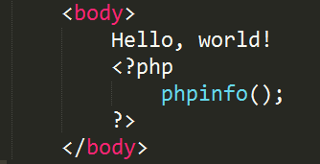
2 - Dynamic web page
Making sure PHP is installed and working fine
Create a file in the Apache Document Root and name it: test2.php
New content:
Navigate to localhost/test2.php

Slide 20
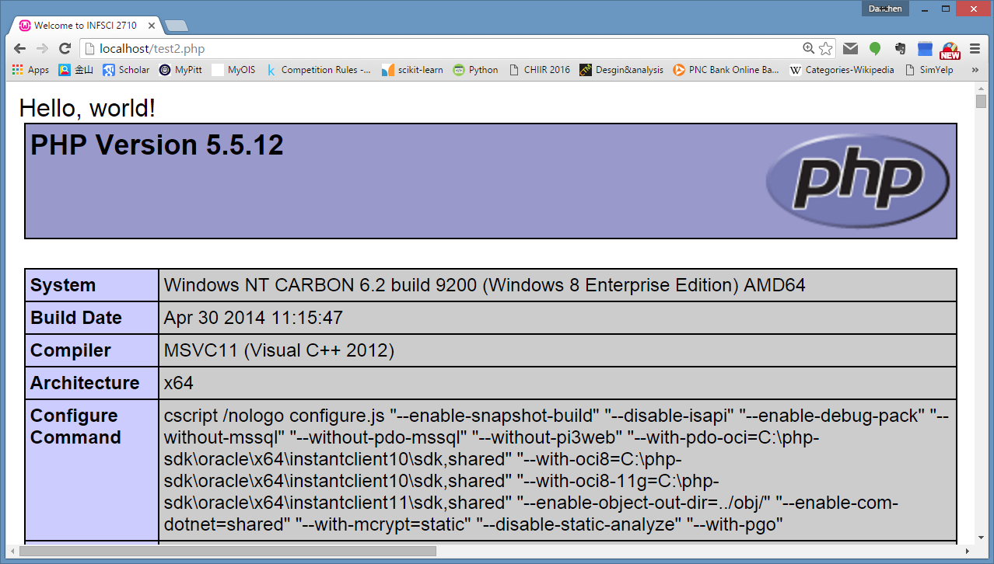
2 - Dynamic web page

Slide 21
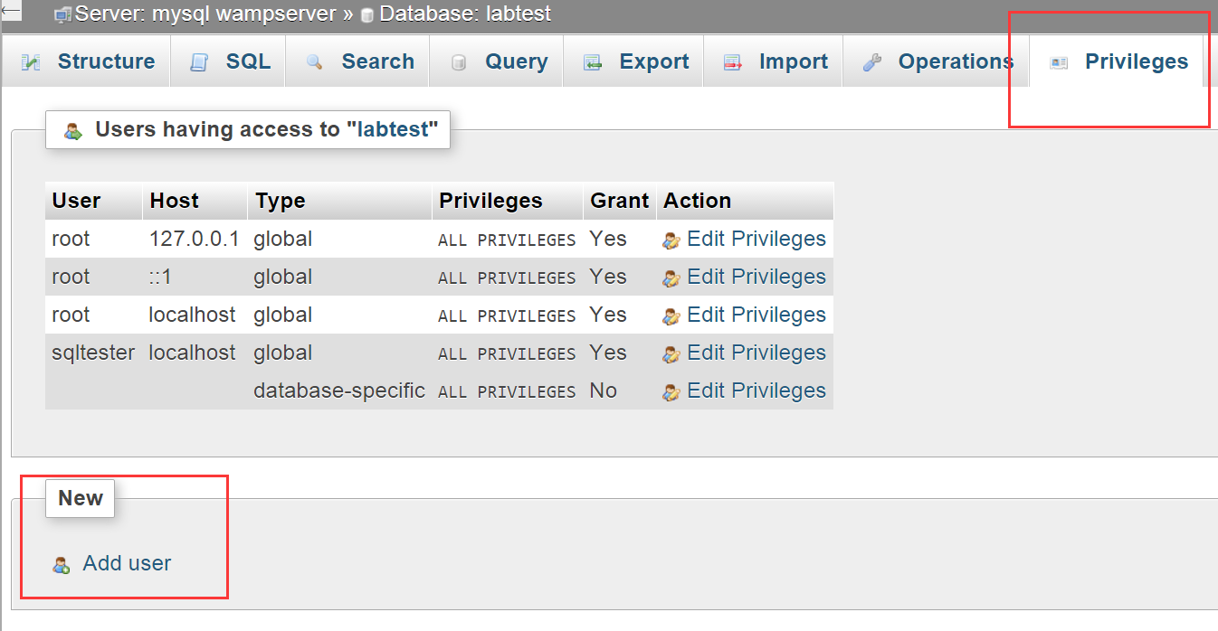
3 - Dynamic web page
Let’s create a MySQL user [demo]
phpMyAdmin=>Privileges=>Add user (Windows)
phpMyAdmin=>User account=>Add user (Mac)
All privileges
Host name: Local

Slide 22
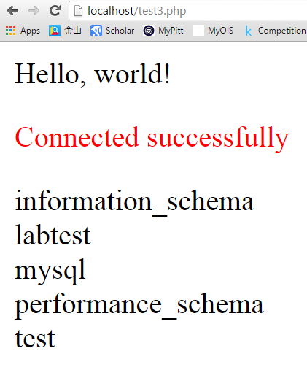
3 - Dynamic web page
Dynamic page to list all databases on the web page.
Create file ‘test3.php’ in Apache Document Root and use the code in test3.php.
Then visit localhost/test3.php

Slide 23
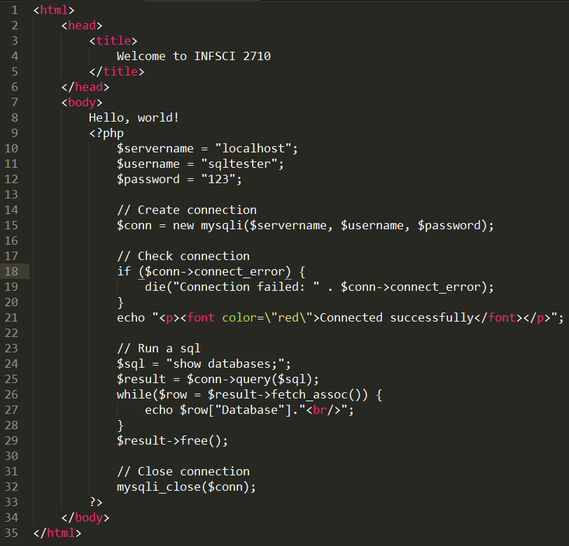
Test3.php

Slide 24
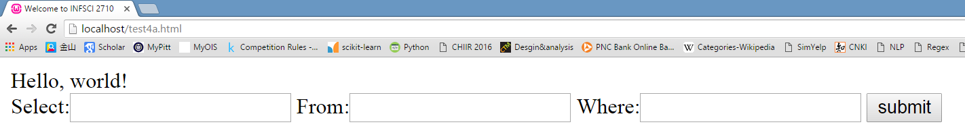
4 - Dynamic web page (4.a)
More “dynamic” page with input parameters
Create a file “test4a.html’ in Apache Document.
From database.tablename

Slide 25
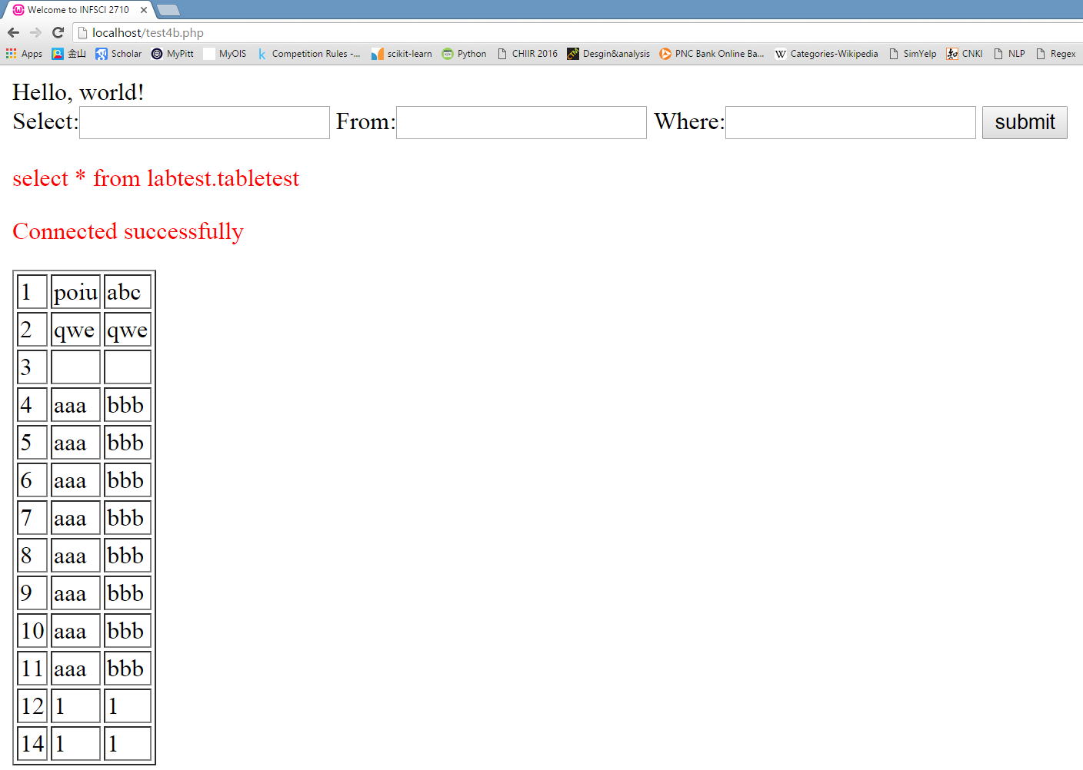
4 - Dynamic web page (4.b)
Create a file “test4b.php” in Apache Document Root

Slide 26
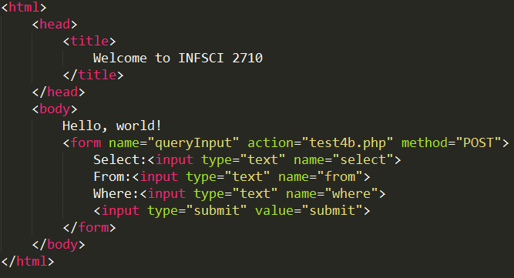
Test4a.html

Slide 27
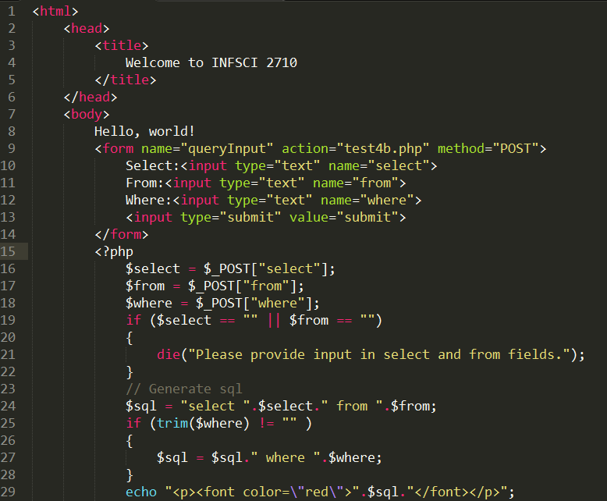
Test4b.php

Slide 28
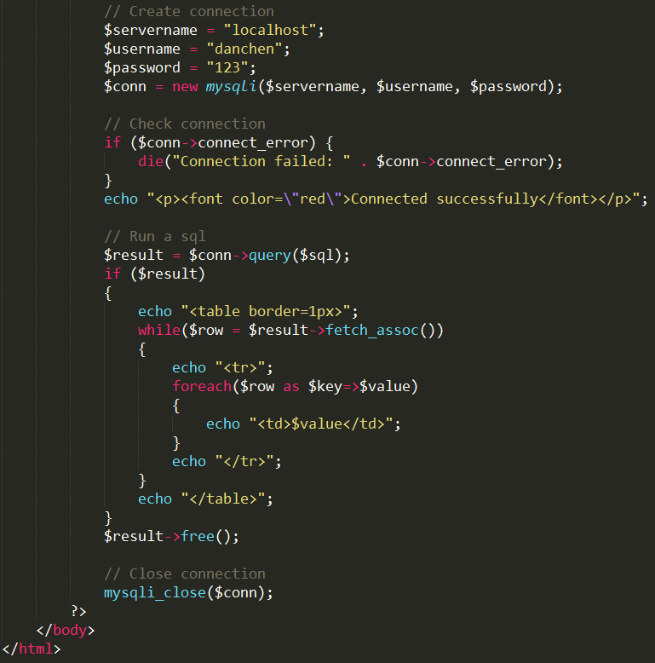
Test4b.php

Slide 29
Class exercise

Slide 30
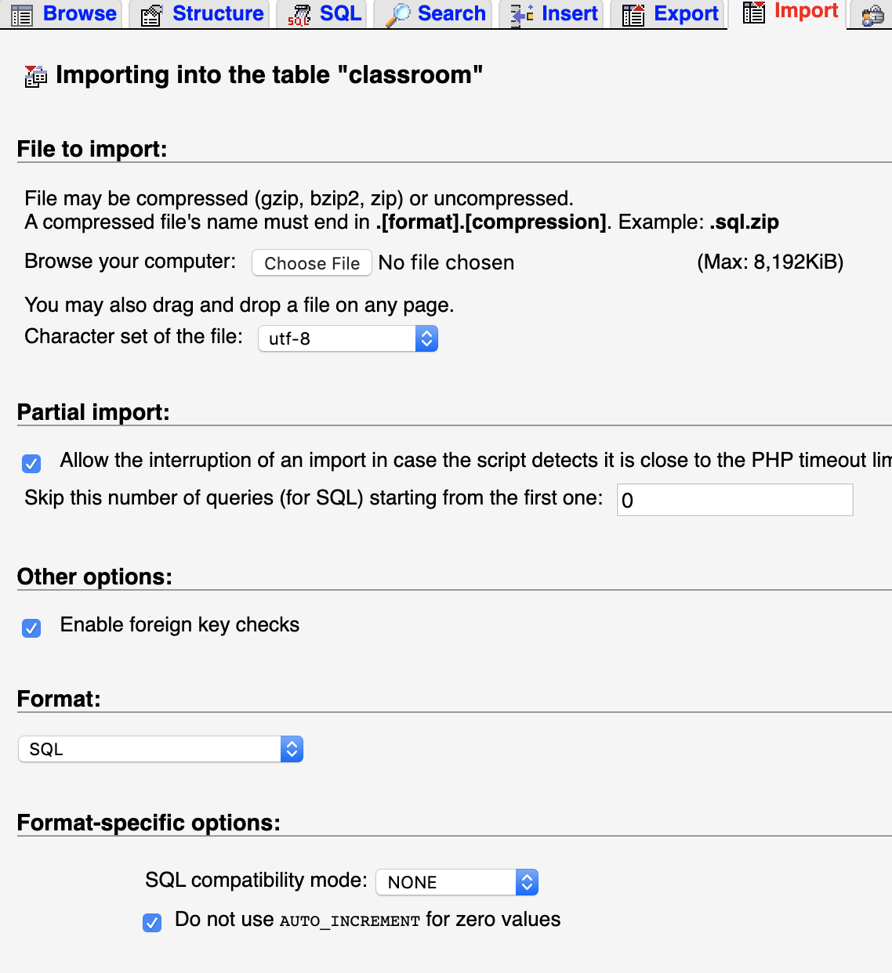
Class exercise
Create a new database, call it “lab_university” and import the ’creatDB.sql’ file that you can find on the class web page
Two ways to import tables:
Open file and copy past the content (if the file is small)
Use Import functionality (MySQL workbench and phpmyadmin both have it)
Insert data from ‘insertData.sql’ file that you can find on the class web page

Slide 31
Exercise
1. Find the names of all the instructors from Biology department
2. Find the names of courses in Computer science department which have 3 credits
3. For the student with ID 12345, show all course_id and title of all courses taken by the student.
4. As above, but show the total number of credits for such courses (taken by that student). Don't display the tot_creds value from the student table, you should use SQL aggregation on courses taken by the student.
5. As above, but display the total credits for each of the students, along with the ID of the student; don't bother about the name of the student. (Don't bother about students who have not registered for any course, they can be omitted)

